Slide 1
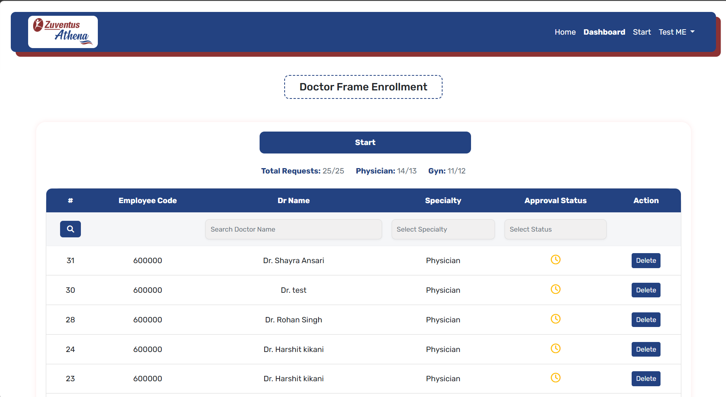
Enroll Doctor
Total Doctors Enrolled

Slide 2
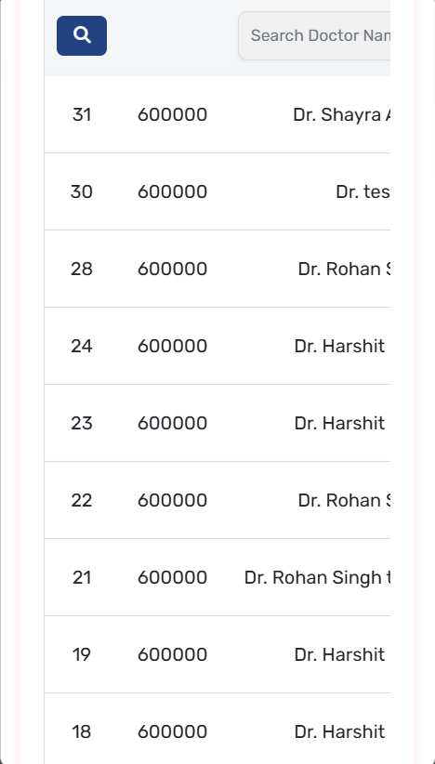
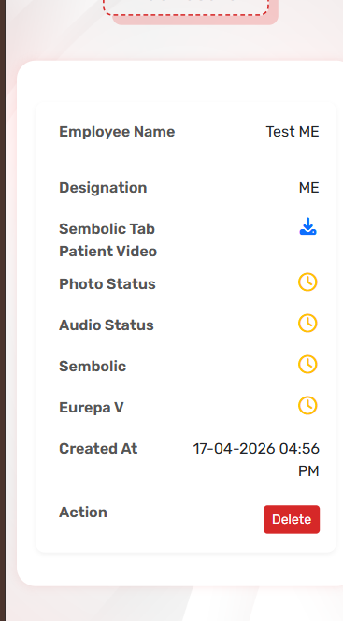
Do not keep scrolling. Show in box for each doctor

Slide 3
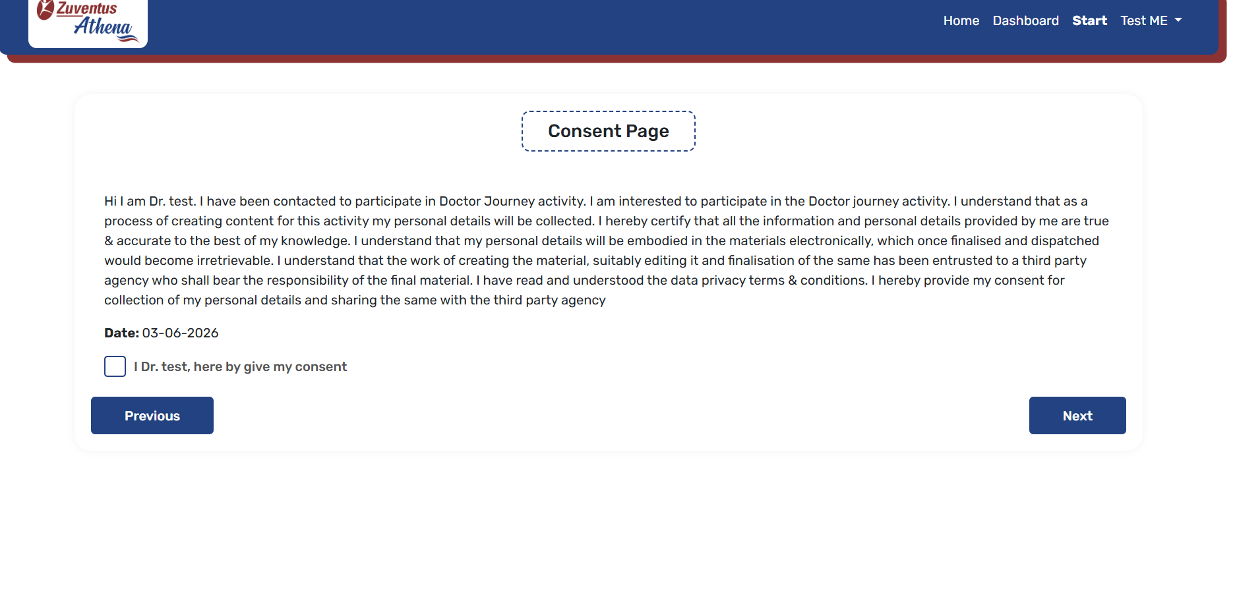
bold

Slide 4
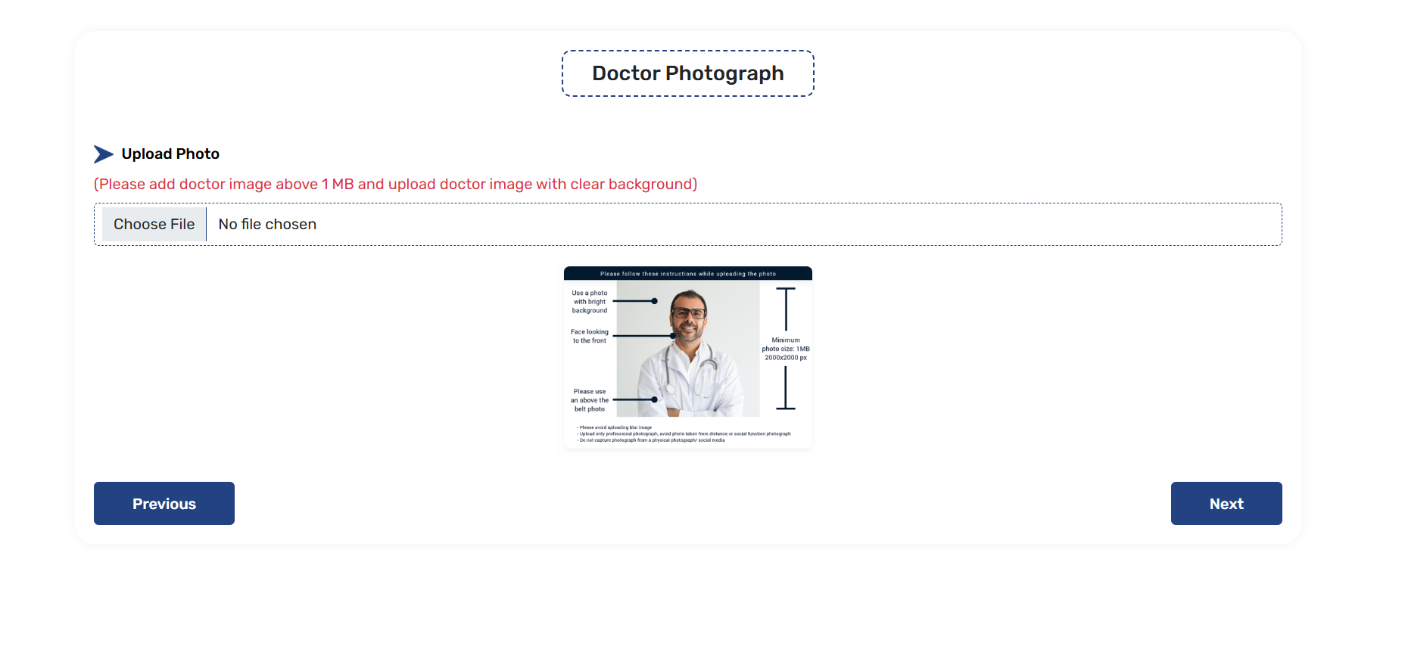
remove

Slide 5
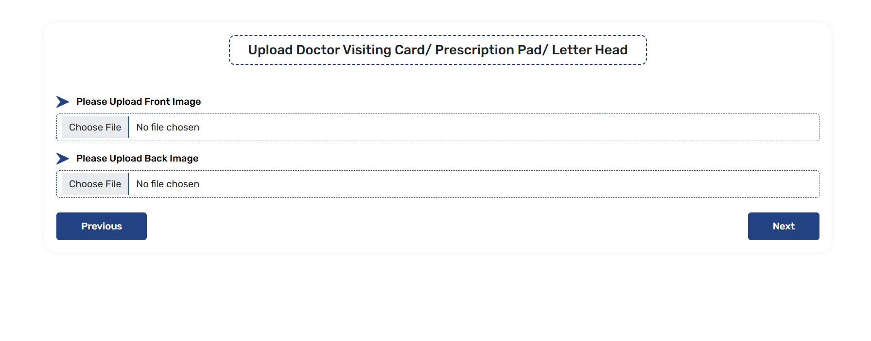
remove

Slide 6
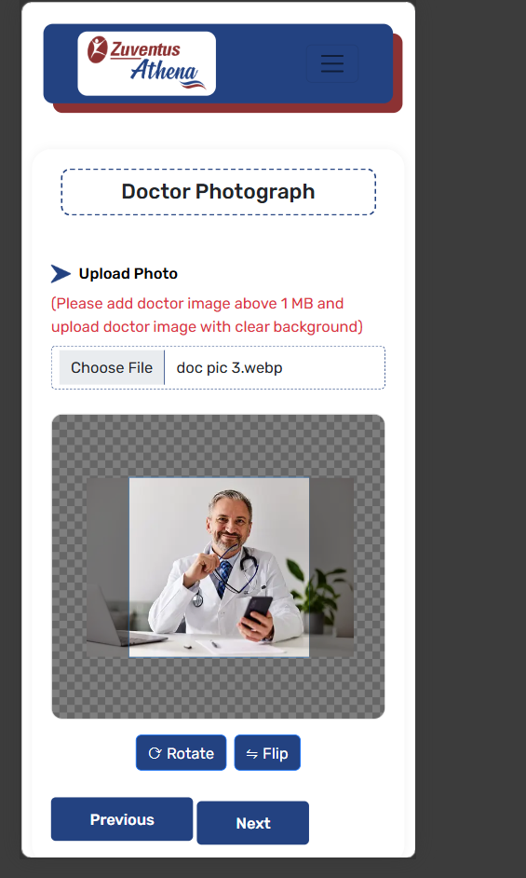
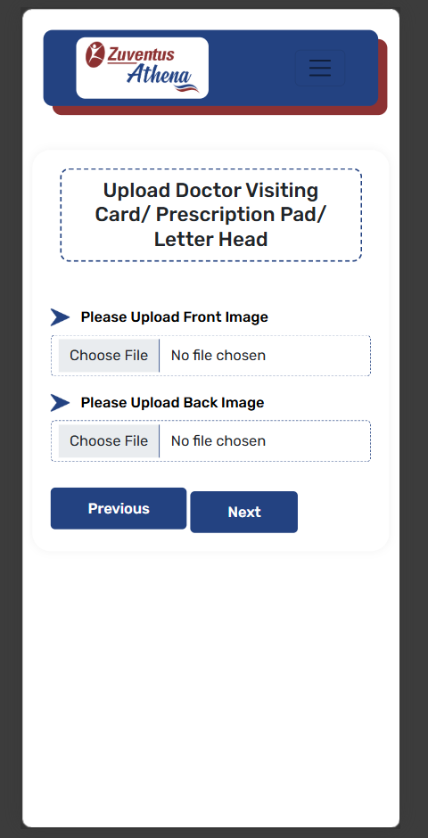
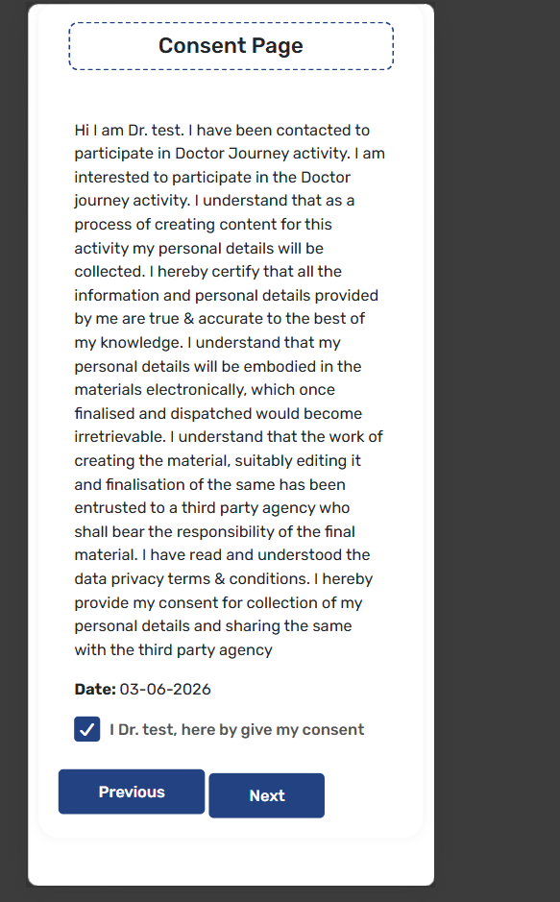



Slide 7
Physician area of expertise
Hypertension
Diabetes
Critical Care Respiratory Diseases
Emergency Medicine
Geriatric Medicine
Allergy
Asthma
Stroke
Migraine & Sleep Disorders
Vaccination
GI Disorders
Infectious Disease
Gyn Area of Expertise
Antenatal Care And Delivery
Painless Delivery
Infertility Treatment
Adolescent Girl Counselling
Pre-conception Counseling
Treatment Of Gynaec Disorders Menopause Clinic
Sonography
Obesity Managememt
Cosmetic Gynaecology
Urogynaecology

Slide 8

Doctor

